Slide 1
Asynchronous JavaScript or How to avoid Callback Hell

Slide 2

Mihails Semjonovs
Currently working in “Accenture” as node/js developer
Overall work experience more than 9 years
Experienced in both: front and back-end

Slide 3


What is Callback ?

Slide 4
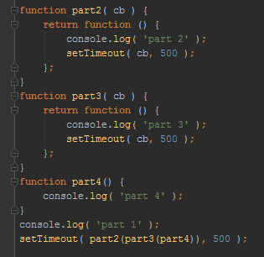
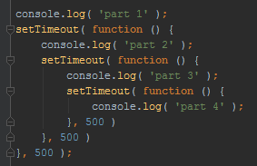
What is callback hell ?

Slide 5

Callback hell example

Slide 6
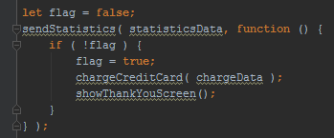
Callback hell example

Slide 7
2 Major Callback Problems:
Inversion of control ( lack of it )
Not mind setted / designed
We can’t trust resources
Too early
Too late
Multiple times
Not a single time
Lost context
Swallow errors
…
We need to switch to different parts of our code to find how it works
We have to remember what’s happened before

Slide 8
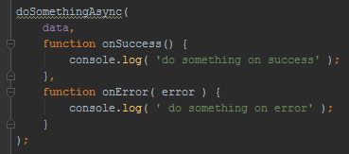
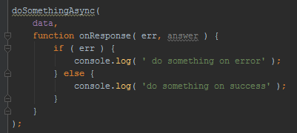
Callback hell non fixes
Multiple callbacks – one for response one for error
Error first ( node style ) error callbacks

Slide 9

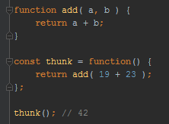
Thunks
In a sync flow thunk is a pure function that needs no parameters to be passed to give you result

Slide 10
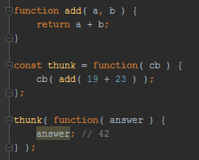
Thunks
In a async flow thunk is a pure function that needs no parameters, except callback, to be passed to give you result

Slide 11
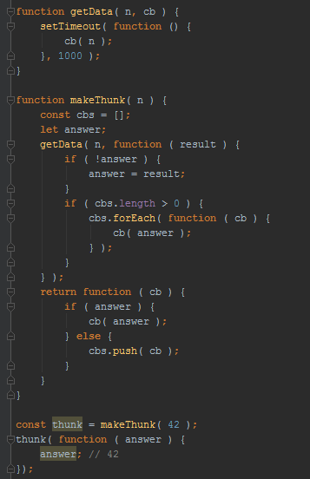
Thunks
Are not solving “Callback Hell” in any way
Understanding thunks you’ll understand Promises

Slide 12
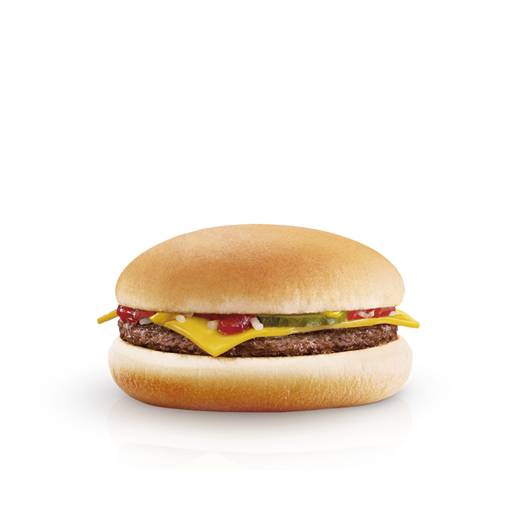
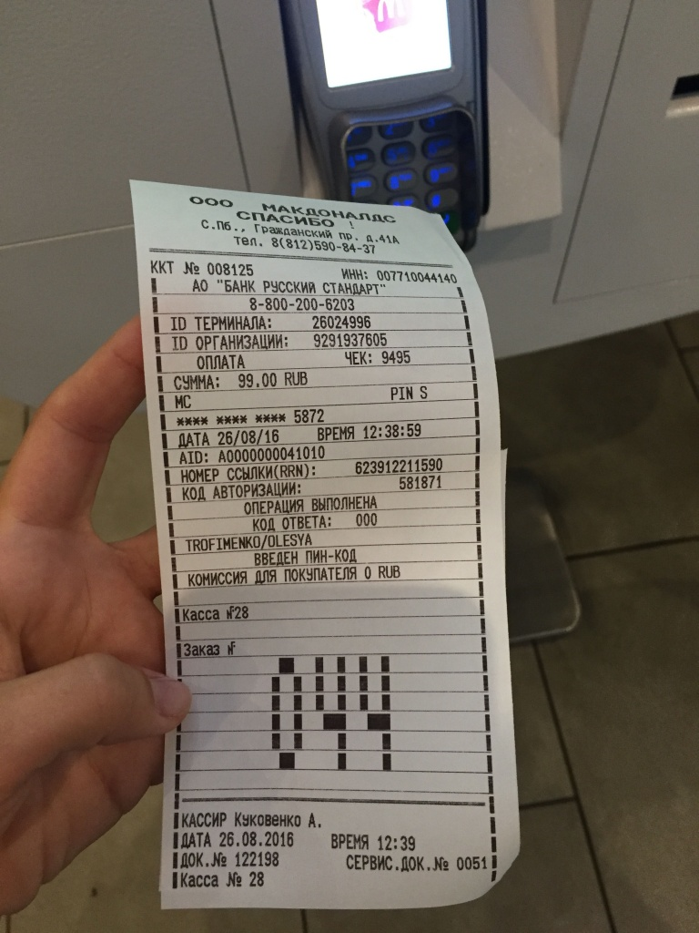
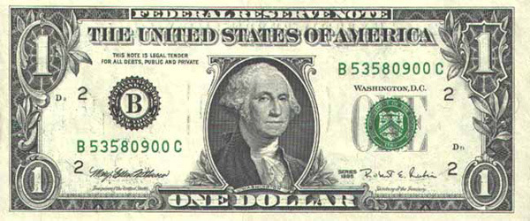
What is Promise ?
Utility
Promise
Value

Slide 13
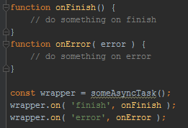
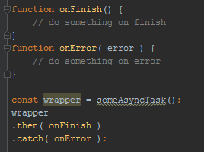
What is Promise ?

Slide 14
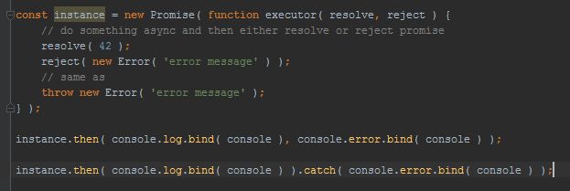

Promise api

Slide 15
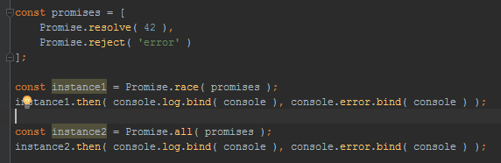
Promise api
Bluebird
Asynquence

Slide 16
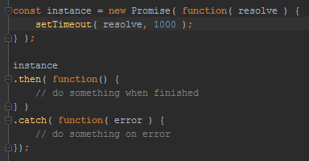
Promises Trust
Only resolved once
Either success or error
Messages passed/kept
Exceptions becomes errors
Immutable once resolved

Slide 17
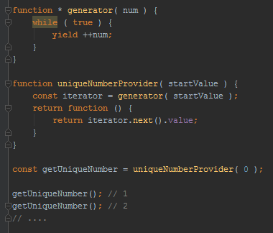
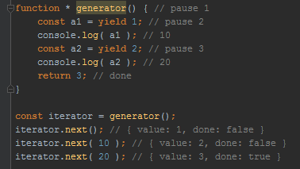
What is generator ?

Slide 18
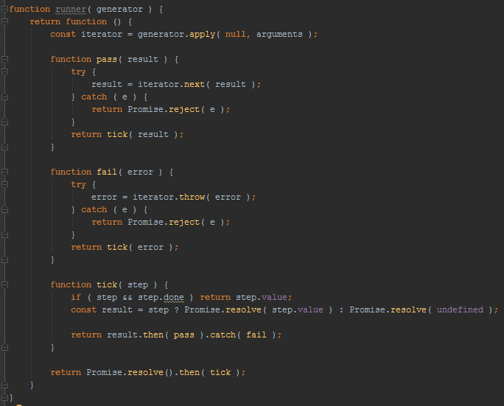
Generator runner

Slide 19
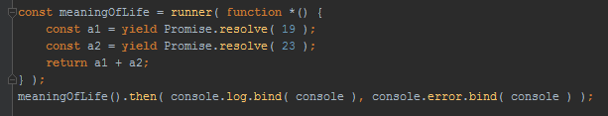
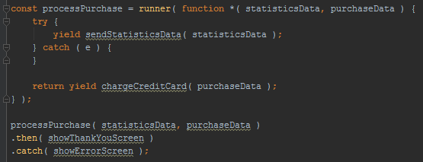
Generator example

Slide 20
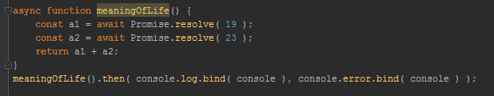
Async/await

Slide 21
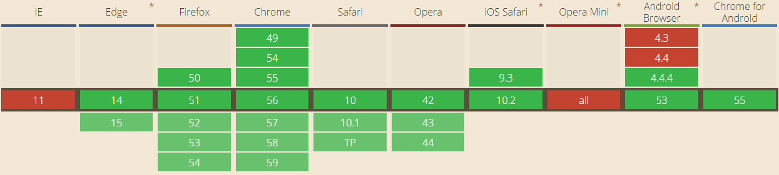
Compatibility of Promise
12
29
33
7.1
20
8
Jul 29 2015
Feb – Mar 2014
Sep 2014

Slide 22
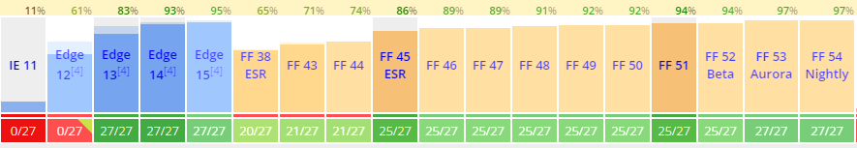
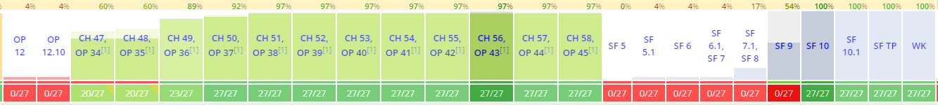
Compatibility of Generators
Nov 2015
Apr – May 2016

Slide 23
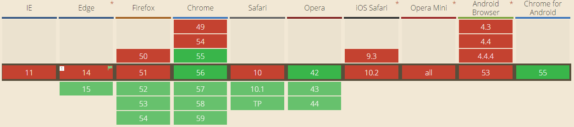
Compatibility of async/await
Dec 2016

Slide 24
Questions ?

